Slide 1

Reinforcement Learning Deep Q – Learning (DQN)

Slide 2
Contents
Deep Q-Learning usage
Why DQN
Difference between Q Learning and DQN
Steps in DQN
Issue with DQN Compared to DNN
Solution for the Issue
To Summarize
Implementation using python
References

Slide 3
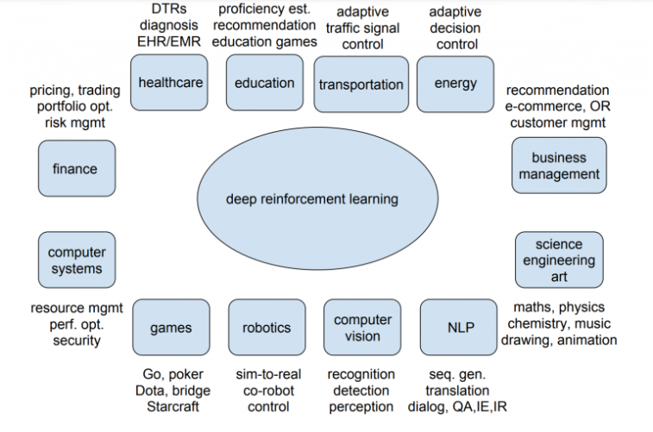
Deep Reinforcement learning used in Real Life
DeepMind :
AlphaZero – Chess, Shogi, Go
Alpha Star - StarCraft II
Industry-ready applications:
Google’s Cloud AutoML
Facebook’s Horizon Platform
Other Uses

Slide 4
Why to use Deep Q learning?
Q-learning is a simple yet quite powerful algorithm to create a cheat sheet for our agent. This helps the agent figure out exactly which action to perform.
But what if this cheatsheet is too long? Imagine an environment with 10,000 states and 1,000 actions per state. This would create a table of 10 million cells. Things will quickly get out of control!

Slide 5
Why to use Deep Q learning?
It is pretty clear that we can’t infer the Q-value of new states from already explored states. This presents two problems:
First, the amount of memory required to save and update that table would increase as the number of states increases
Second, the amount of time required to explore each state to create the required Q-table would be unrealistic
If we approximate these Q-values with machine learning models such as a neural network, it will save a lot of computation power and time.

Slide 6
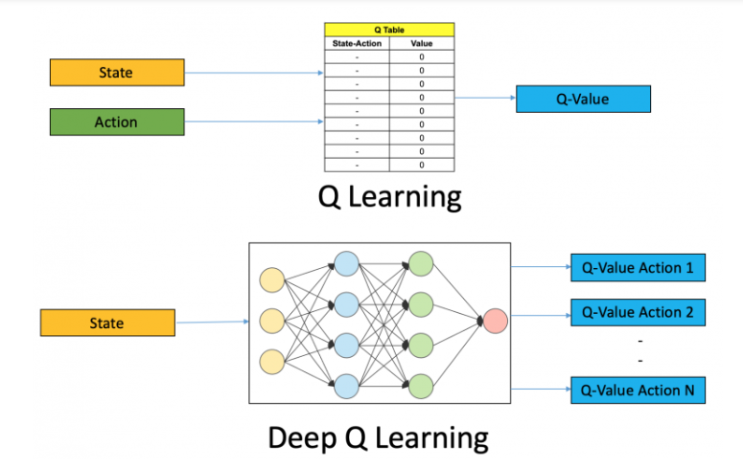
Difference between Q Learning and DQN

Slide 7

Steps in DQN
So, what are the steps involved in reinforcement learning using deep Q-learning networks (DQNs)?
All the past experience is stored by the user in memory
The next action is determined by the maximum output of the Q-network
The loss function here is mean squared error of the predicted Q-value and the target Q-value – Q*. This is basically a regression problem. However, we do not know the target or actual value here as we are dealing with a reinforcement learning problem. Going back to the Q-value update equation derived fromthe Bellman equation. we have:
The section in green represents the target. We can argue that it is predicting its own value, but since R is the unbiased true reward, the network is going to update its gradient using backpropagation to finally converge.

Slide 8
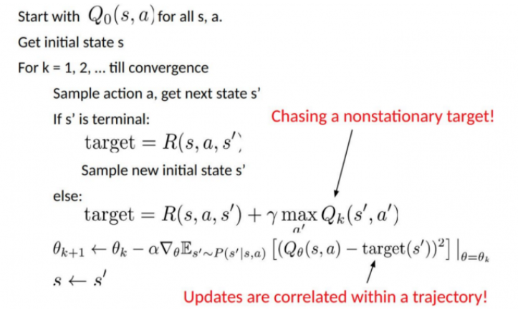
Issue with DQN Compared to DNN
Non-stationary or unstable target:
As you can see in the above code, the target is continuously changing with each iteration. In deep learning, the target variable does not change and hence the training is stable, which is just not true for RL

Slide 9
Issue with DQN Compared to DNN
To summarise, we often depend on the policy or value functions in reinforcement learning to sample actions. However, this is frequently changing as we continuously learn what to explore. As we play out the game, we get to know more about the ground truth values of states and actions and hence, the output is also changing.
So, we try to learn to map for a constantly changing input and output.

Slide 10
Solution?
1. Target Network
Since the same network is calculating the predicted value and the target value, there could be a lot of divergence between these two. So, instead of using 1one neural network for learning, we can use two.
We could use a separate network to estimate the target. This target network has the same architecture as the function approximator but with frozen parameters. For every C iterations (a hyperparameter), the parameters from the prediction network are copied to the target network. This leads to more stable training because it keeps the target function fixed (for a while):

Slide 11
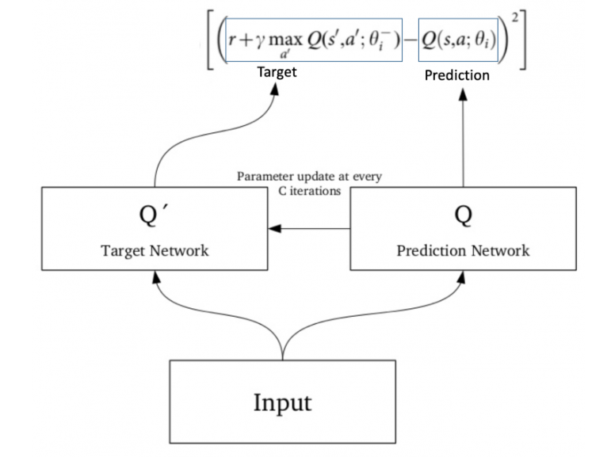
Solution!

Slide 12
Solution!
2. Experience Replay
To perform experience replay, we store the agent’s experiences – 𝑒𝑡=(𝑠𝑡,𝑎𝑡,𝑟𝑡,𝑠𝑡+1)
What does the above statement mean? Instead of running Q-learning on state/action pairs as they occur during simulation or the actual experience, the system stores the data discovered for [state, action, reward, next_state] – in a large table.
Let’s understand this using an example.
Suppose we are trying to build a video game bot where each frame of the game represents a different state. During training, we could sample a random batch of 64 frames from the last 100,000 frames to train our network. This would get us a subset within which the correlation amongst the samples is low and will also provide better sampling efficiency.

Slide 13
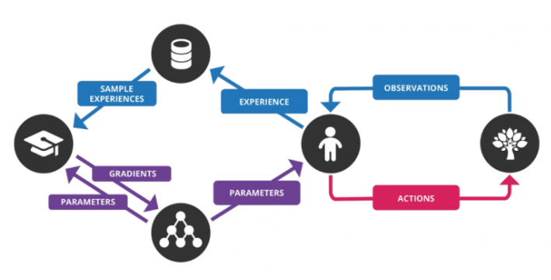
To summarize

Slide 14
To summarize
Steps involved in a deep Q-network (DQN) :
Preprocess and feed the game screen (state s) to our DQN, which will return the Q-values of all possible actions in the state
Select an action using the epsilon-greedy policy. With the probability epsilon, we select a random action a and with probability 1-epsilon, we select an action that has a maximum Q-value, such as a = argmax(Q(s,a,w))
Perform this action in a state s and move to a new state s’ to receive a reward. This state s’ is the preprocessed image of the next game screen. We store this transition in our replay buffer as <s,a,r,s’>
Next, sample some random batches of transitions from the replay buffer and calculate the loss
It is known that:
which is just the squared difference between target Q and predicted Q
Perform gradient descent with respect to our actual network parameters in order to minimize this loss
After every C iterations, copy our actual network weights to the target network weights
Repeat these steps for M number of episodes

Slide 15
Implementing Deep Q-Learning in Python using Keras & OpenAI Gym
We will make an agent that can play a game called CartPole.
Goal of CartPole is to balance a pole that’s connected with one joint on top of a moving cart.
There are four kinds of information given by the state (such as the angle of the pole and position of the cart).
An agent can move the cart by performing a series of actions of 0 or 1, pushing the cart left or right.

Slide 16
References
Deep Q-Learning | An Introduction To Deep Reinforcement Learning (analyticsvidhya.com)
Deep Q-Learning – GeeksforGeeks
Deep Q-Learning Tutorial: minDQN. A Practical Guide to Deep Q-Networks | by Mike Wang | Towards Data Science
Implementing Deep Q-Learning using Tensorflow - GeeksforGeeks

